Slide 1
Structured Query Language
(SQL)
Data Types: Click here to Read Oracle’s Data Types

Slide 2
Introduction to SQL
What is SQL?
SQL stands for Structured Query Language.
SQL is used to create, remove, alter the database and database objects in a database management system and to store, retrieve, update the data in a database.
SQL is a standard language for creating, accessing, manipulating database management system.

Slide 3
Introduction to SQL
Concept of SQL
The user specifies a certain condition.
The program will go through all the records in the database file and select those records that satisfy the condition (searching).
Statistical information of the data.
The result of the query will then be stored in form of a table.

Slide 4
Introduction to SQL
Different Types of SQL Commands:
DDL (Data Definition Language).
DML (Data Manipulation Language).
DCL (Data Control Language).
TCL (Transaction Control Language).
DQL (Data Query Language).

Slide 5
DDL: Data Definition Language
All DDL commands are auto-committed. That means it saves all the changes permanently in the database.
Command | Description
Create | to create new table or database
Alter | for alteration
Truncate | delete data from table
Drop | to drop a table
Rename | to rename a table

Slide 6
DML: Data Manipulation Language
DML commands are not auto-committed. It means changes are not permanent to database, they can be rolled back.
Command | Description
Insert | to insert a new row
Update | to update existing row
Delete | to delete a row
Merge | merging two rows or two tables

Slide 7
TCL: Transaction Control Language
These commands are to keep a check on other commands and their effect on the database. These commands can annul changes made by other commands by rolling back to original state. It can also make changes permanent.
.
Command | Description
Commit | to permanently save
Rollback | to undo change
Savepoint | to save temporarily

Slide 8
DCL : Data Control Language
Data control language provides command to grant and take back authority.
Command | Description
Grant | grant permission of right
Revoke | take back permission.

Slide 9
Data Definition Language
DDL consists of the SQL commands that can be used to define the database schema.
Deals with descriptions of the database schema
Used to create and modify the structure of database objects in the database.
List of Commands: Create, Drop, and Alter

Slide 10
Data Definition Language
Create: It is used to create a table
Syntax: Create table tablename (column1 data_type (size), column2 data_type (size)…);
Query:
Create table Customer (CustomerId number, CustomerName char(20), ContactNo number, address varchar (20), city char(20), Postalcode varchar(20), country char (20);

Slide 11
Data Definition Language
Alter command
alter command is used for alteration of table structures. There are various uses of alter command, such as,
to add a column to existing table
to rename any existing column
to change datatype of any column or to modify its size.
alter is also used to drop a column.

Slide 12
Data Definition Language
Alter command
To Add Column to existing Table
Using alter command we can add a column to an existing table. Following is the Syntax,
alter table table-name add(column-name datatype);
Here is an Example for this,
alter table Students add (address varchar(50));
This command will add a new column address to the Students table

Slide 13
Data Definition Language
Alter command
To Add Multiple Column to existing Table
Using alter command we can even add multiple columns to an existing table. Following is the Syntax,
alter table table-name add(column-name1datatype1, column-name2datatype2);
Here is an Example for this,
alter table students add (dob number(10), city varchar(10));

Slide 14
Data Definition Language
Alter command
To Add column with Default Value
Alter command can add a new column to an existing table with default values. Following is the Syntax.
alter table table-name add(column-name1 datatype1 default data);
alter table students add (branch varchar(10) default ‘COE');

Slide 15
Data Definition Language
Alter command
To Modify an existing Column
alter command is used to modify data type of an existing column . Following is the Syntax,
alter table table-name modify(column-name datatype);
Here is an Example for this,
The above command will modify address column of the Students table
alter table students modify (address char(30));

Slide 16
Data Definition Language
Alter command
To Rename a column
Using alter command you can rename an existing column. Following is the Syntax,
alter table table-name rename column old-column-name to column-name;
Here is an Example for this,
alter table Student rename address to Location;
The above command will rename address column to Location.

Slide 17
Data Definition Language
Alter command
To Drop a Column
alter command is also used to drop columns also. Following is the Syntax,
alter table table-name drop(column-name);
Here is an Example for this,
alter table Students drop (address);

Slide 18
Data Definition Language
Truncate command
Truncate command removes all records from a table. But this command will not destroy the table's structure. When we apply truncate command on a table its Primary key is initialized. Following is its Syntax,
truncate table table-name
Here is an Example explaining it.
The above query will delete all the records of students table.
truncate table students;

Slide 19
Data Definition Language
Drop command
Drop query completely removes a table from database. This command will also destroy the table structure.
Following is its Syntax,
drop table table-name;
;
Here is an Example explaining it.
The above query will delete the students table completely. It can also be used on Databases. For Example, to drop a database,
drop table students;
drop database Test;
The above query will drop a database named Test from the system

Slide 20
Data Definition Language
Rename query
Rename command is used to rename a table. Following is its Syntax,
rename old_table_name to new_table_name;
Here is an Example explaining it.
The above query will rename Students table to People.
rename students to people;

Slide 21
Data Manipulation Language
The SQL commands that deals with the manipulation of data present in the database.
Insert, select, select distinct, update are DML commands.
Insert: Insert is used to insert values in the created table
Syntax: Insert into tablename values (column1, column2,…column);
Query: Insert into customer values(1, ‘Aman Sharma’, ‘Obere Str. 57’,’Berlin’,12209,’Germany’);

Slide 22
Data Manipulation Language
1) INSERT command
Insert command is used to insert data into a table. Following is its general syntax,
INSERT into table-namevalues(data1,data2,..)
Consider a table Student with following fields. Students(Roll, Name, Age)
insert into Students values(1, 'mani',22);
insert into Students values(2, 'mahi',24);
insert into Students values(3, 'appy',20);

Slide 23
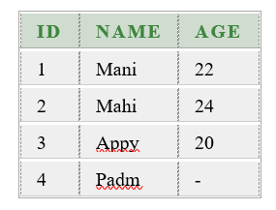
Data Manipulation Language
1) INSERT command
Example to Insert NULL value to a column
The statements below will insert NULL value into age column of the Student table.
insert into students values(4,'padm',null);
Example to Insert Default value to a column
insert into students values(5,'rahul', default);
Suppose the age column of student table has default value of 18, then for the age field 18 value will ne added in new record.

Slide 24
Data Manipulation Language
2) UPDATE command
Update command is used to update a row of a table. Following is its general syntax,
UPDATEtable-name set column-name = value where condition;
Lets see an example,
update students set age=22 where id=4;
Example to Update multiple columns
update students set name='pri',age=25 where id=5;

Slide 25
Data Manipulation Language
3) Delete command
Delete command is used to delete data from a table. Delete command can also be used with condition to delete a particular row. Following is its general syntax,
DELETE from table-name;
Example to Delete all Records from a Table
delete from students;
The above command will delete all the records from Students table.
Example to Delete a particular Record from a Table
delete from students where id=5;
The above command will delete the record where id is 5 from Students table.

Slide 26
Data Query Language
SQL Query: SELECT
Select query is used to retrieve data from a tables.
It is the most used SQL query.
We can retrieve complete tables, or partial by mentioning conditions using WHERE clause.

Slide 27
Basic structure of an SQL query

Slide 28
Example: North wind Sample Dataset (Customer Table)
CustomerID | CustomerName | ContactName | Address | City | PostalCode | Country
1 | Aman | Sharma | Obere Str. 57 | Berlin | 12209 | Germany
2 | Rohan | Garg | Avda. de la Constitución 2222 | México D.F. | 05021 | Mexico
3 | Mohan | Goel | Mataderos 2312 | México D.F. | 05023 | Mexico
4 | Sohan | wadhwa | 120 Hanover Sq. | London | WA1 1DP | UK
5 | Kawal | Sahni | Berguvsvägen 8 | Luleå | S-958 22 | Sweden
6 | Aarohan | Verma | 125 Hanover Sq. | London | WA1 1DP | UK
The table above contains six records and seven columns (CustomerID, CustomerName, ContactName, Address, City, PostalCode, and Country).

Slide 29
General Structure: Select Statement
Select: It is used to extract data from a database.
Syntax: SELECT [* / DISTINCT] expr1 [col1], expr2 [col2] FROM tablename WHERE condition;
* will extract all columns of table including duplicates values.
DISTINCT will extract only the value which are unique.
expr1, expr2 can be a column name or any expression of a function.
col1 and col2 are the particular column names you want to extract.
tablename is the name of the table from which you want to extract the values.
Where clause is used where you want to extract columns of some specific value.

Slide 30
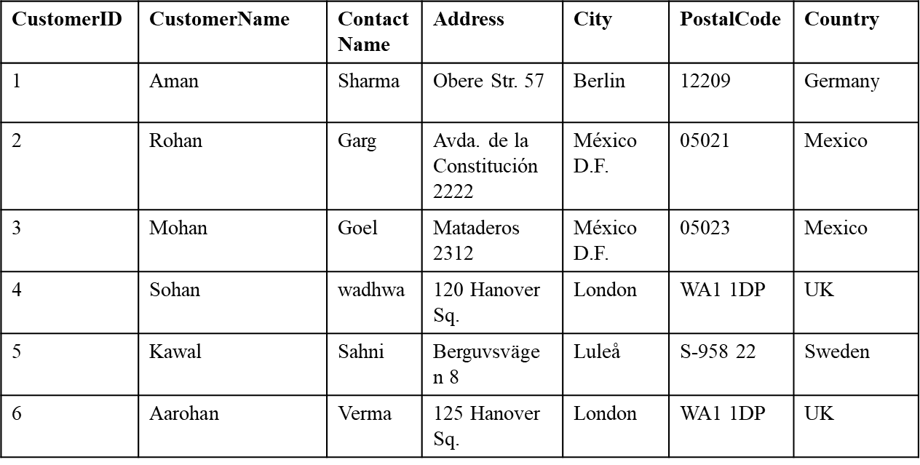
Examples: Select Statement
Note: We are using the Customer Table for all the examples.
eg 1. Select all values from customer
Query: Select * from Customer;
Output:

Slide 31
Examples: Select Statement
Note: We are using the Customer Table for all the examples.
eg 2. Extract distinct city from customer table.
Query: Select DISTINCT City from Customer;
Output: The customer database consists of 6 rows in which 4 cities are distinct. Therefore four cities are extracted as shown below.
City
Berlin
México D.F.
Luleå
London

Slide 32
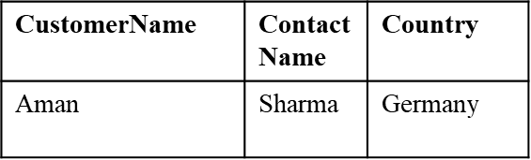
Examples: Select Statement
Note: We are using the Customer Table for all the examples.
eg 3. Extract customerName and Contact Name of Germany People
from customer table.
Query: Select customerName, ContactName from Customer where country = ‘Germany’;
Output:

Slide 33
Examples: Select Statement
Note: We are using the Customer Table for all the examples.
eg 4. Extract all values of customer id 1 from customer table.
Query: Select * from Customer where id = 1;
Output:
CustomerID | CustomerName | ContactName | Address | City | PostalCode | Country
1 | Aman | Sharma | Obere Str. 57 | Berlin | 12209 | Germany

Slide 34
Examples: Select Statement
Note: We are using the Customer Table for all the examples.
eg 5. Extract Customer name, Contact name and postal code of Mexico D.F city of Mexico People.
Query: Select CustomerName, ContactName, PostalCode from Customer where City=‘Mexico D.F.’ AND Country=‘Mexico’;
Output:
CustomerName | ContactName | PostalCode
Rohan | Garg | 05021
Mohan | Goel | 05023

Slide 35
Update Statement
Update Command is used to update the records in the table
Syntax: UPDATE table_name SET column1 = value1, column2 = value2...., columnN = valueN WHERE [condition];
Query: Update Customer set CustomerName=‘abc’, where City=‘Berlin.’ AND Country=‘Germany’;
Output:
CustomerID | CustomerName | ContactName | Address | City | PostalCode | Country
1 | abc | Sharma | Obere Str. 57 | Berlin | 12209 | Germany

Slide 36
Comparison
.
.
IN: The IN command allows you to specify multiple values in a WHERE clause. The IN operator is a shorthand for multiple OR conditions.
Syntax: Select col1 from tablename Where IN ( value1, value2, value3);
Between: The BETWEEN command is used to select values within a given range. The values can be numbers, text, or dates.
Syntax: Select col1 from tablename Where condition BETWEEN Value1 AND Value2;
Like: The LIKE command is used in a WHERE clause to search for a specified pattern in a column.
Syntax: Select col1 from tablename Where col like ‘val1’;

Slide 37
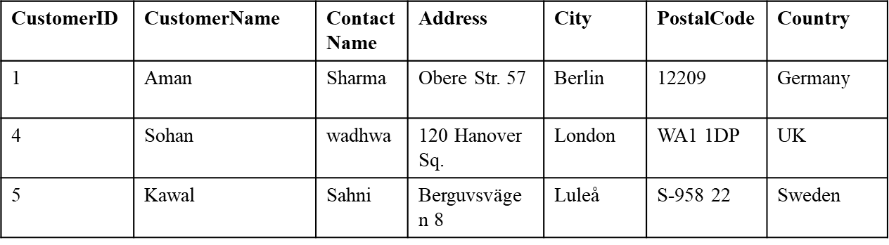
Comparison (IN)
.
.
Note: We are using the Customer Table for all the examples.
eg 1. Extract all values from customer table of id 1, 4 and 5.
Query: Select * from Customer where id IN (1,4,5);
Output:

Slide 38
Comparison (Not IN)
.
.
Note: We are using the Customer Table for all the examples.
eg 2. Extract all values from customer table who are not from London and Berlin.
Query: Select * from Customer where city NOT IN (‘London’, Berlin’);
Output:
CustomerID | CustomerName | ContactName | Address | City | PostalCode | Country
2 | Rohan | Garg | Avda. de la Constitución 2222 | México D.F. | 05021 | Mexico
3 | Mohan | Goel | Mataderos 2312 | México D.F. | 05023 | Mexico
5 | Kawal | Sahni | Berguvsvägen 8 | Luleå | S-958 22 | Sweden

Slide 39
Comparison (Between)
.
.
Note: We are using the Customer Table for all the examples.
eg 3. Extract all values from customer table between 2 to 5.
Query: Select * from Customer where CustomerId Between 2 and 5;
Output:
CustomerID | CustomerName | ContactName | Address | City | PostalCode | Country
3 | Mohan | Goel | Mataderos 2312 | México D.F. | 05023 | Mexico
4 | Sohan | wadhwa | 120 Hanover Sq. | London | WA1 1DP | UK

Slide 40
Comparison (Like)
.
.
Note: We are using the Customer Table for all the examples.
eg 4. Extract all values from customer table with a CustomerName ending with n.
Query: Select * from Customer where CustomerName LIKE ‘%n’
Output:
CustomerID | CustomerName | ContactName | Address | City | PostalCode | Country
1 | Aman | Sharma | Obere Str. 57 | Berlin | 12209 | Germany
2 | Rohan | Garg | Avda. de la Constitución 2222 | México D.F. | 05021 | Mexico
3 | Mohan | Goel | Mataderos 2312 | México D.F. | 05023 | Mexico
4 | Sohan | wadhwa | 120 Hanover Sq. | London | WA1 1DP | UK
6 | Aarohan | Verma | 125 Hanover Sq. | London | WA1 1DP | UK

Slide 41
Comparison (LIKE)
.
.
Note: We are using the Customer Table for all the examples.
eg 5. Extract all values from customer table with a CustomerName starting with a.
Query: Select * from Customer where CustomerName LIKE ‘a%’
Output:
CustomerID | CustomerName | ContactName | Address | City | PostalCode | Country
1 | Aman | Sharma | Obere Str. 57 | Berlin | 12209 | Germany
6 | Aarohan | Verma | 125 Hanover Sq. | London | WA1 1DP | UK

Slide 42
The following SQL (LIKE)
.
.
Note: We are using the Customer Table for all the examples.
eg 6. Selects all customers with a CustomerName starting with a.
Query: Select * from Customer where CustomerName LIKE ‘a%’
Output:
CustomerID | CustomerName | ContactName | Address | City | PostalCode | Country
1 | Aman | Sharma | Obere Str. 57 | Berlin | 12209 | Germany
6 | Aarohan | Verma | 125 Hanover Sq. | London | WA1 1DP | UK

Slide 43
The following SQL (LIKE)
.
.
Note: We are using the Customer Table for all the examples.
eg 6. Selects all customers with a CustomerName that have “ha" in any position.
Query: Select * from Customer where CustomerName LIKE ‘%ha%’
Output:
CustomerID | CustomerName | ContactName | Address | City | PostalCode | Country
2 | Rohan | Garg | Avda. de la Constitución 2222 | México D.F. | 05021 | Mexico
3 | Mohan | Goel | Mataderos 2312 | México D.F. | 05023 | Mexico
4 | Sohan | wadhwa | 120 Hanover Sq. | London | WA1 1DP | UK
6 | Aarohan | Verma | 125 Hanover Sq. | London | WA1 1DP | UK

Slide 44
Logical Operators AND, OR, NOT
The AND, OR and NOT operators are used to filter records based on more than one condition:
The AND operator displays a record if all the conditions separated by AND are TRUE.
The OR operator displays a record if any of the conditions separated by OR is TRUE.
The NOT operator displays a record if the condition(s) is NOT TRUE.

Slide 45
AND
Syntax: SELECT column1, column2, ... FROM table_name WHERE condition1 AND condition2 AND condition3 ...;
Query: Select DeptId and Salary from employee where name=‘Anjali’ and city=‘Bangalore’
Output:
DeptId | Salary
1014 | 58000

Slide 46
OR
Syntax: SELECT column1, column2, ... FROM table_name WHERE condition1 OR condition2 OR condition3 ...;
Query: Select DeptId and Salary from employee where name=‘Anjali’ or city=‘Bangalore’
Output:
DeptId | Salary
1014 | 58000
1003 | 34000
1014 | 45000

Slide 47
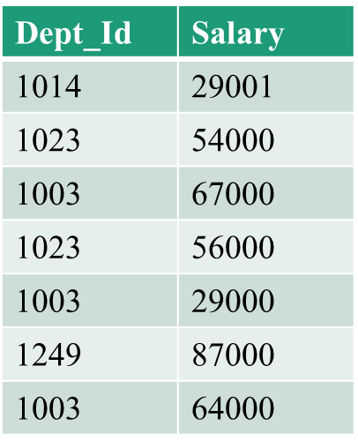
NOT
Syntax: SELECT column1, column2, ... FROM table_name WHERE NOT condition1;
Query: Select DeptId and Salary from employee where city< >‘Bangalore’
Output:

Slide 48
Set Operations in SQL
SQL supports few Set operations which can be performed on the table data. These are used to get meaningful results from data stored in the table, under different special conditions.
UNION
UNION ALL
INTERSECT
MINUS

Slide 49
Union Operation in SQL UNION is used to combine the results of two or more SELECT statements. However, it will eliminate duplicate rows from its result set. In case of union, number of columns and datatype must be same in both the tables, on which UNION operation is being applied.
The union of A and B (A∪B)
A
B
A table containing all the rows from A and B.

Slide 50
Union
Syntax: SELECT ...... FROM ...... WHERE ......
UNION
SELECT ...... FROM ...... WHERE ......;

Slide 51
Table1 Table2
SELECT * FROM Table1 UNION SELECT * FROM Table2;
OUTPUT
ID | Name
1 | abhi
2 | adam
ID | Name
2 | adam
3 | chester
ID | NAME
1 | abhi
2 | adam
3 | chester

Slide 52

Union All
This operation is similar to Union. But it also shows the duplicate rows.
SELECT * FROM Table1 UNION ALL SELECT * FROM Table2;
OUTPUT
ID | NAME
1 | abhi
2 | adam
2 | adam
3 | chester

Slide 53

Intersection
Intersect operation is used to combine two SELECT statements, but it only returns the records which are common from both SELECT statements. In case of Intersect the number of columns and datatype must be same.
SELECT * FROM Table1 INTERECT SELECT * FROM Table2;
OUTPUT
ID | NAME
2 | adam

Slide 54

Difference or Minus
The Minus operation combines results of two SELECT statements and return only those in the final result, which belongs to the first set of the result.
SELECT * FROM Table1 MINUS SELECT * FROM Table2;
OUTPUT
ID | NAME
1 | abhi

Slide 55
More Examples
Customer
Employee
first_name | last_name
Stephen | Jones
Mark | Smith
Denise | King
Paula | Johnson
Richard | Archer
first_name | last_name
Christina | Jones
Michael | McDonald
Paula | Johnson
Stephen | Jones
Richard | Smith

Slide 56
Union
eg 1. Combine both customer and employee table.
Query:
Select first_name, last_name from Customer
UNION
Select first_name, last_name from Employee

Slide 57
Union
Output:
First_name | last_name
Stephen | Jones
Mark | Smith
Denise | King
Paula | Johnson
Richard | Archer
Christina | Jones
Michael | McDonald
Richard | Smith

Slide 58
Union
Example 2. Combine both customer and employee table in ascending order.
Query:
Select first_name, last_name from Customer
UNION
Select first_name, last_name from Employee Order

Slide 59
Intersection
SELECT ...... FROM table1 ;
Intersect
SELECT col FROM table2
eg 2. Find common first_name and last_name from both customer and employee table.
Query:
Select first_name, last_name from customer
Intersect
Select first_name, last_name from customer;

Slide 60
Intersection
Output:
FIRST_NAME | LAST_NAME
Paula | johnson
Stephen | jones
You can also use IN to find intersection

Slide 61
Difference of Tables
SELECT ...... FROM table1 ;
SELECT col FROM table2 )
eg 3. Find first name and last name from customer which are not in employee.
Query:
Select * from customer
MINUS
Select * from employee;

Slide 62
Difference of Tables
Output:
FIRST_NAME | LAST_NAME
Denise | king
Mark | Smith
Richard | Archer
You can also use NOT IN to find difference.

Slide 63
Grouping
eg. 11 List the number of students of each class.

Slide 64
Group By Class
class
1A
1A
1A
1A
COUNT( )
1A
1B
1B
1B
1B
1B
COUNT( )
1B
1B
1B
1C
1C
1C
COUNT( )
1C
1C
Student

Slide 65
Grouping
eg. 11 List the number of students of each class.
SELECT class, COUNT(*) FROM student
GROUP BY class;
Result

Slide 66
Grouping
eg. 12 List the average Math test score of each class.

Slide 67
Group By Class
class
1A
1A
AVG( )
1A
1A
1B
1B
1B
1B
AVG( )
1B
1B
1B
1C
1C
AVG( )
1C
1C
Student

Slide 68
Grouping
eg. 12 List the average Math test score of each class.
SELECT class, AVG(mtest) FROM student GROUP BY class;
Result

Slide 69
Grouping, Cont’d…
The GROUP BY command is used to group the result set (used with aggregate functions: COUNT, MAX, MIN, SUM, AVG).
Syntax: SELECT ...... FROM ...... WHERE condition
GROUP BY groupexpr [HAVING requirement];
– groupexpr specifies the related rows to be grouped as one entry. Usually it is a column.
– WHERE condition specifies the condition of individual rows before the rows are group. HAVING requirement specifies the condition involving the whole group.

Slide 70
Grouping
Note: Consider the following table for further queries .
ID | Dept_Id | Name | City | Salary
1 | 1014 | Ajay | Bangalore | 58000
2 | 1014 | Harry | Delhi | 29001
3 | 1003 | Anjali | Bangalore | 34000
4 | 1023 | Rahul | Delhi | 54000
5 | 1003 | Anisha | Chennai | 67000
6 | 1023 | Rajni | Mumbai | 56000
7 | 1003 | Zaid | Mumbai | 29000
8 | 1249 | Bib | NY | 87000
9 | 1014 | Raj | Bangalore | 45000
10 | 1003 | Arya | Chennai | 64000

Slide 71
Grouping (AVG)
eg 1. find the average salary for each department’s employees
Query: Select Dept_Id, AVG (Salary) from Employee Group BY Dept_ID
Output:
Dept_ID | AVG (Salary)
1014 | 44000.3333
1003 | 48500.0000
1023 | 55000.0000
1249 | 87000.0000

Slide 72
Grouping (Count)
eg 2. List the number of employees from each city
Query: Select City, COUNT(City) from Employee Group BY City;
Output:
City | Count (City)
Bangalore | 3
Delhi | 2
Chennai | 2
Mumbai | 2
NY | 1

Slide 73
Grouping with Order By
eg 3. List the number of employees from each city in ascending order
Query: Select City, COUNT(City) from Employee Group BY City ORDER By COUNT(City);
Output:
City | Count (City)
NY | 1
Delhi | 2
Chennai | 2
Mumbai | 2
Bangalore | 3

Slide 74
Grouping with Order By
eg 4. List the number of employees from each city in descending order
Query: Select City, COUNT(City) from Employee Group BY City ORDER By COUNT(City) DESC;
Output:
City | Count (City)
Bangalore | 3
Delhi | 2
Chennai | 2
Mumbai | 2
NY | 1

Slide 75
Grouping (MAX)
eg 5. Find the maximum salary for each department with “Dept_ID” greater than 1003.
Query: Select Dept_ID, MAX(Salary) from Employee where Dept_ID>1003 Group BY Dept_ID;
Output:
Dept_ID | MAX (Salary)
1014 | 58000
1023 | 56000
1249 | 87000

Slide 76
Grouping (MIN)
eg 6. Find the minimum salary for each department with “Dept_ID” greater than 1003.
Query: Select Dept_ID, MIN(Salary) from Employee where Dept_ID>1003 Group BY Dept_ID;
Output:
Dept_ID | MAX (Salary)
1014 | 29001
1023 | 54000
1249 | 87000

Slide 77
Grouping (SUM)
eg 7. Find the total salary of all the employees:
Query: Select Count(Dept_ID), SUM(Salary) from Employee.
Output:
(Count) Dept_ID | SUM (Salary)
10 | 5230001

Slide 78
Grouping (Count)
eg 8. Find the number of employees from each city in all the departments.
Query: Select City, Dept_ID, Count (*) from Employee Group By City, Dept_ID Order By Count (*);
Output:
City | Dept_ID | Count (*)
Delhi | 1014 | 1
Bangalore | 1003 | 1
Delhi | 1023 | 1
Mumbai | 1023 | 1
Mumbai | 1003 | 1
NY | 1249 | 1
Bangalore | 1014 | 2
Chennai | 1003 | 2

Slide 79
Grouping with Having
eg 9. Find the cities with multiple employees.
Query: Select City, Count (City) from Employee Group By City Having Count (City)>1 Order By Count (City);
Output:
City | Count (City)
Delhi | 2
Chennai | 2
Mumbai | 2
Bangalore | 3

Slide 81
END

